Slide 1
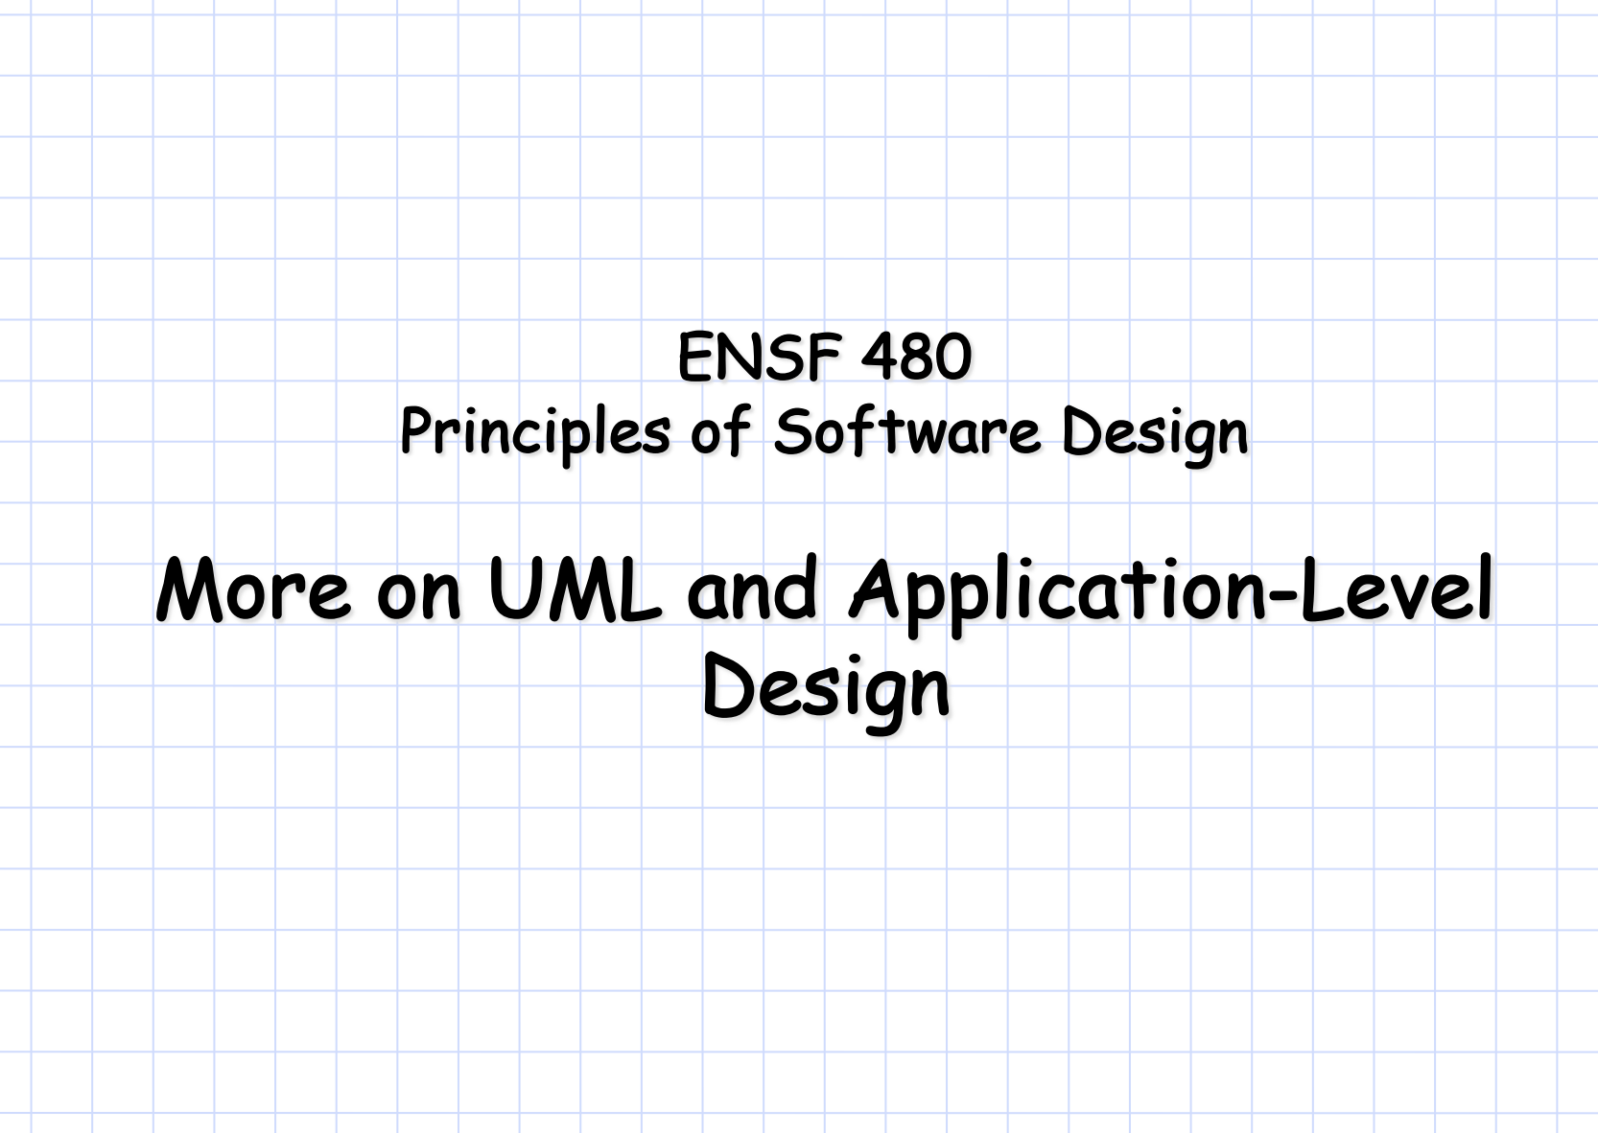

Slide 2
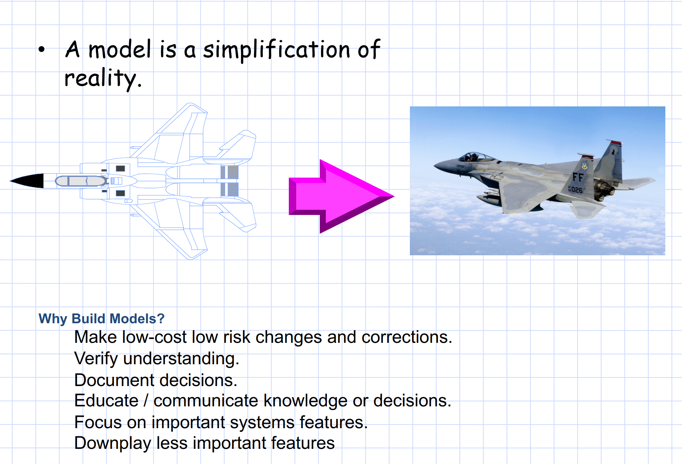
Notes:
Make Low-Cost, Low-Risk Changes and Corrections
Models allow designers to experiment with changes and improvements without affecting the real system. By testing out ideas on a model, designers can identify potential issues early on, avoiding costly mistakes in the actual system.
Verify Understanding
A model provides a shared visual reference, helping team members and stakeholders confirm that they’re on the same page about the system's structure and function.
Document Decisions
Models are a valuable tool for documentation. They capture decisions made during the design process, providing a record of the system's architecture and design rationale.
Educate and Communicate Knowledge or Decisions
Models are often used to explain complex systems to those who might not be familiar with all the technical details, such as clients, stakeholders, or new team members.
Focus on Important System Features
Models help highlight the most critical elements of the system, allowing designers to focus on the parts that matter most without getting distracted by less important details.
Downplay Less Important Features
In addition to focusing on critical aspects, models allow less significant details to be downplayed or omitted entirely. This approach keeps the model from becoming overly complicated or cluttered.
For example, minor features or implementation details that don’t impact the overall design can be left out of high-level models. This simplification makes it easier for teams to discuss and iterate on the essential components without distraction.

Slide 3
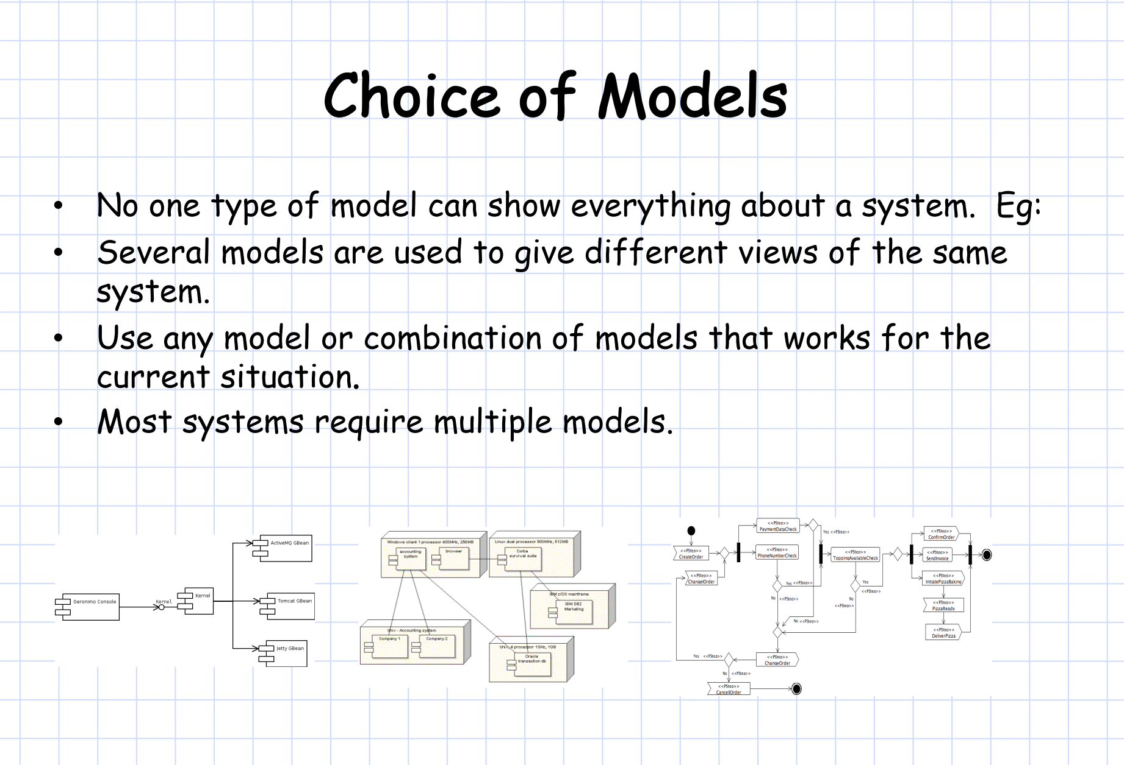
Notes:
No One Type of Model Can Show Everything About a System
Explanation: This point emphasizes that each model provides a different perspective and serves a unique purpose. A single model cannot capture all the nuances of a complex system.
Example: In a software application, a class diagram might capture the structure of the system by showing classes and relationships, while a sequence diagram might illustrate the flow of interactions over time. Neither model, on its own, provides a complete view of the system's structure and behavior.

Slide 4
Notes:
Several Models are Used to Give Different Views of the Same System
Explanation: To fully understand and design a system, multiple models are necessary to capture various dimensions—such as structure, behavior, and interactions. This modular approach allows each model to focus on specific aspects without overcomplicating any single representation.
Component Diagram: Shows major software components and their interconnections.
Deployment Diagram: Depicts how software components are deployed on hardware nodes, giving insight into physical infrastructure requirements.
Sequence Diagram: Demonstrates the order of messages between objects or components, illustrating the flow of a specific process.

Slide 5
Notes:
Use Any Model or Combination of Models That Works for the Current Situation
Explanation: This point highlights flexibility in modeling. Not every model type is required for every project. Designers should choose models based on the specific needs and focus areas of the current project stage.
Example: If the project is in early planning, high-level models like use case diagrams and activity diagrams may suffice. As development progresses, more detailed models, such as class and sequence diagrams, might become necessary to capture finer details for implementation.
Most Systems Require Multiple Models
Explanation: Complex systems cannot be effectively represented by a single model. To gain a comprehensive understanding, designers typically rely on multiple, interconnected models.

Slide 6
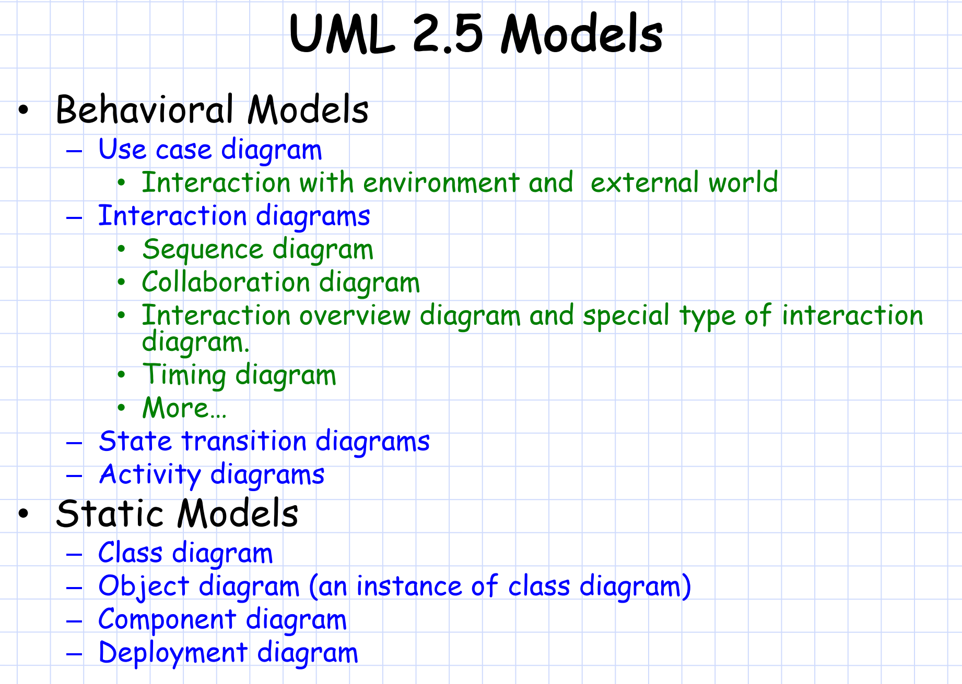
Notes:
Behavioral Models
Behavioral models in UML are used to represent the dynamic aspects of a system, capturing how objects and components interact and change over time. Here are the key types of behavioral models listed on the slide:
Use Case Diagram
Purpose: Shows the system's functionality from the end user’s perspective by capturing interactions between the system and external entities (actors).
Static Models
Static models, also known as structural models, represent the stable, unchanging aspects of a system. These diagrams capture the architecture and structure rather than dynamic interactions.

Slide 7
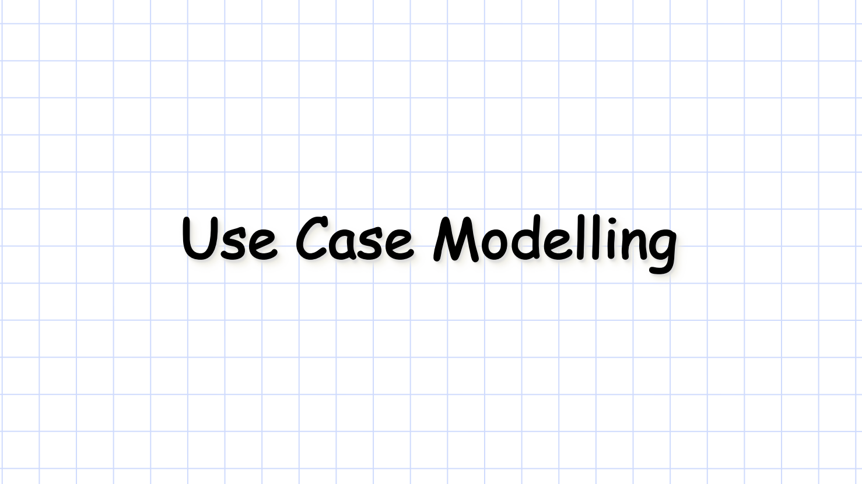

Slide 8
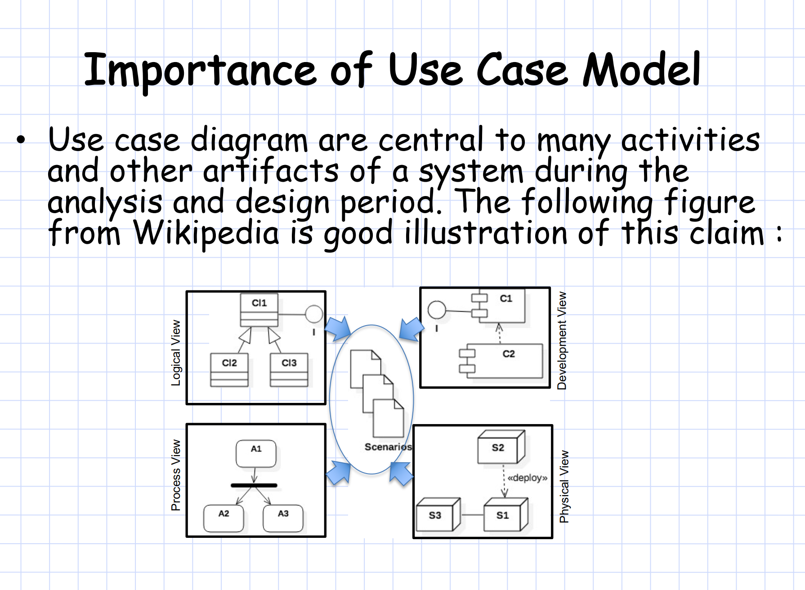
Notes:
Use case diagrams link to various views of the system serve as a foundation for other design activities by providing a high-level view of the system's goals and how different users interact with it.
Logical View: Represents the structure and behavior of the system. Use cases help define the necessary classes and objects (such as CI1, CI2, and CI3) and their relationships, which form the basis for the logical architecture.
Development View: Focuses on the organization of the software components and modules.
Process View: Captures the dynamic aspects of the system, such as workflows and interactions.
Physical View: Shows the physical deployment of the system in the real world.
Illustrates Scenarios and Interactions:
The central "Scenarios" section indicates that use cases support different scenarios, which represent specific ways the system is expected to be used.

Slide 9
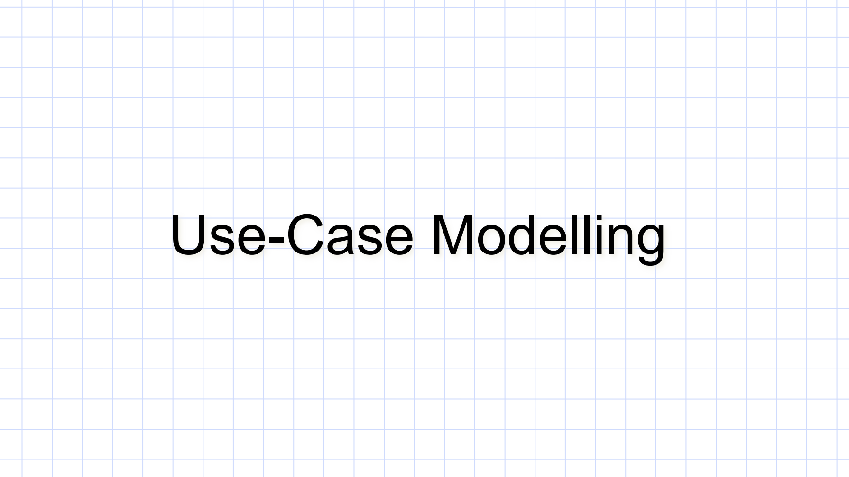

Slide 10
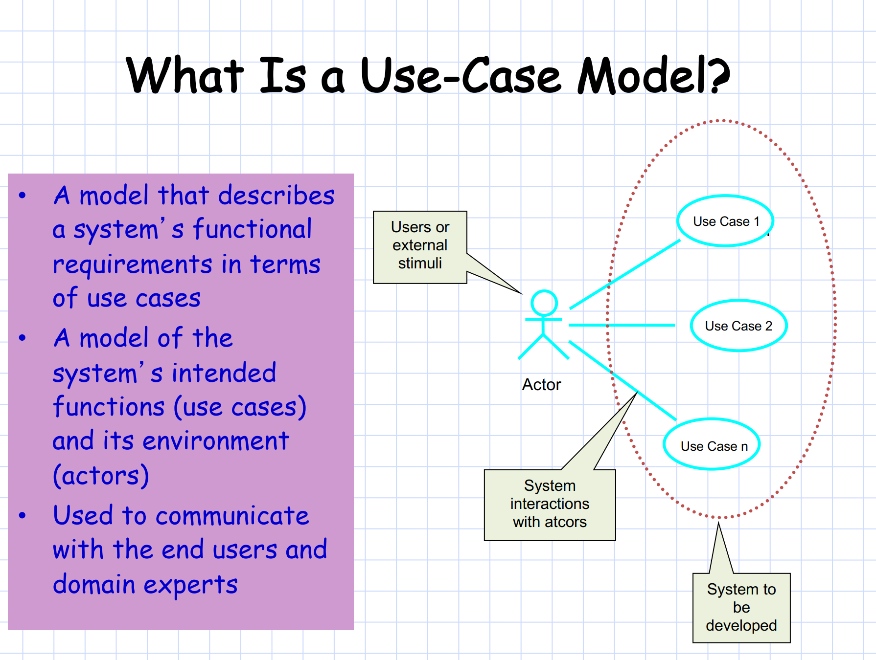
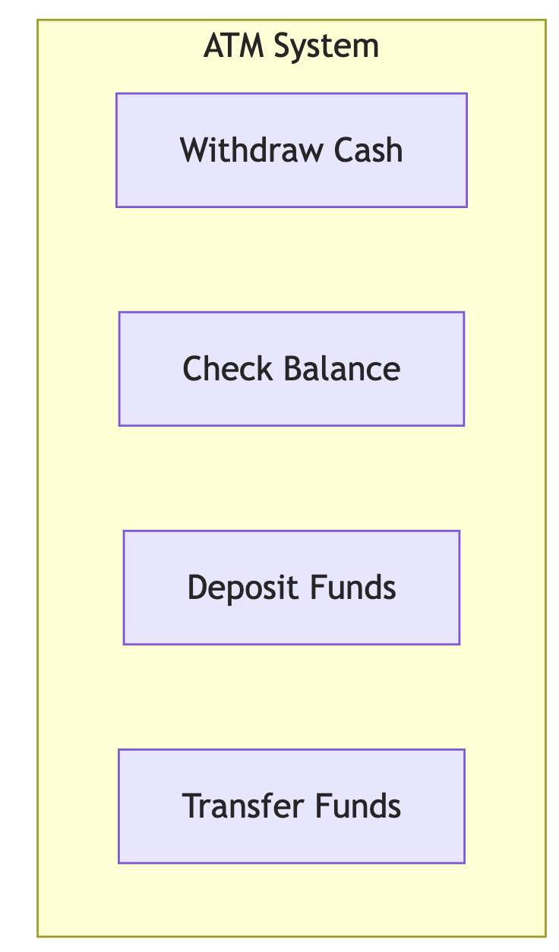
Notes:
Functional Requirements: A use-case model is a way to describe a system’s functional requirements using use cases. Functional requirements specify what the system should do, and use cases are the specific scenarios or actions that fulfill those requirements.
System and Environment Representation: It serves as a model that shows both the system's intended functions (use cases) and its environment (actors). This dual view captures the actions the system must perform and the external entities it interacts with.
Communication Tool: The use-case model is used to communicate requirements with end users and domain experts. It’s a high-level, easy-to-understand representation that helps stakeholders visualize the system’s behavior without needing technical details.

Slide 11
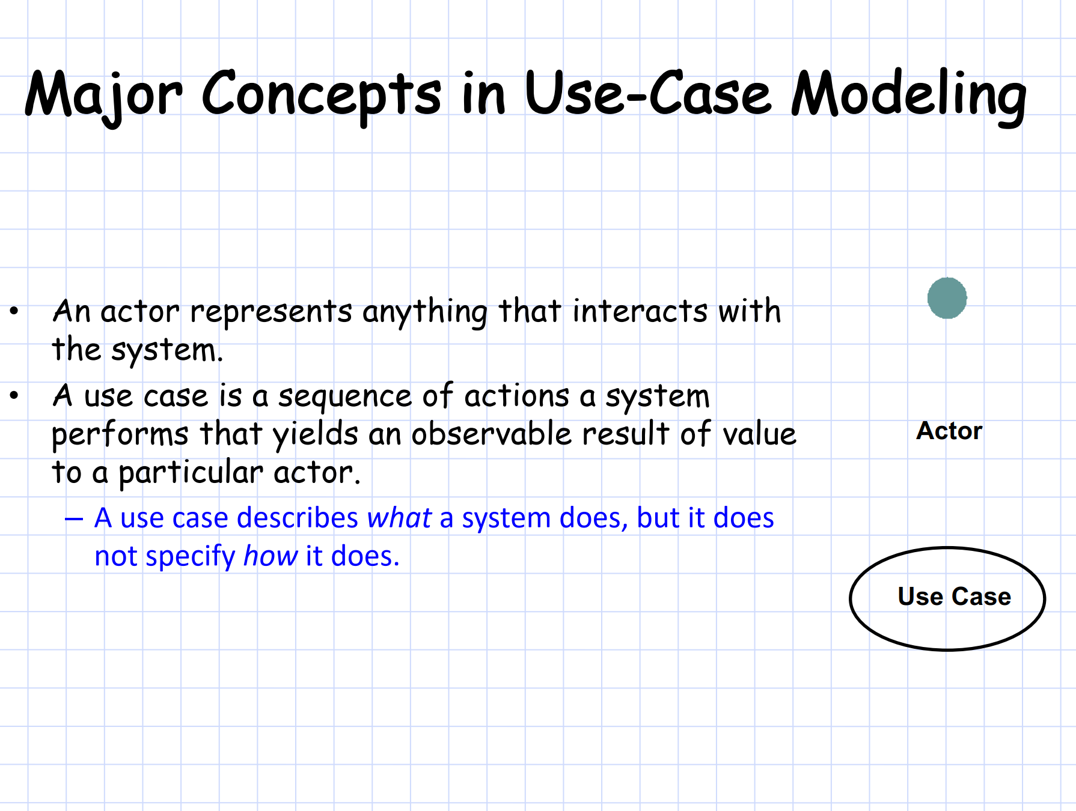
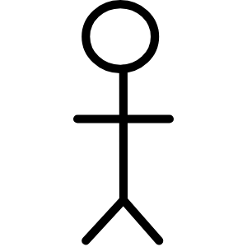
Maintenance Technician
Customer
Bank server
Notes:
An actor represents anything external that interacts with the system. This can include human users, other systems, devices, or any entity that has a role in initiating or receiving responses from the system.
Actors are essential because they define who or what interacts with the system and provide context to each use case. Identifying actors helps clarify the system's boundaries and the entities it needs to support.
A use case is a sequence of actions that the system performs, which yields an observable and valuable result for a particular actor. Each use case is designed to fulfill a specific goal that an actor wants to achieve by interacting with the system.
In an ATM system, use cases might include "Withdraw Cash," "Deposit Funds," and "Check Balance." Each of these represents a unique function that the system provides to fulfill specific needs of the actor (e.g., the customer).

Slide 12
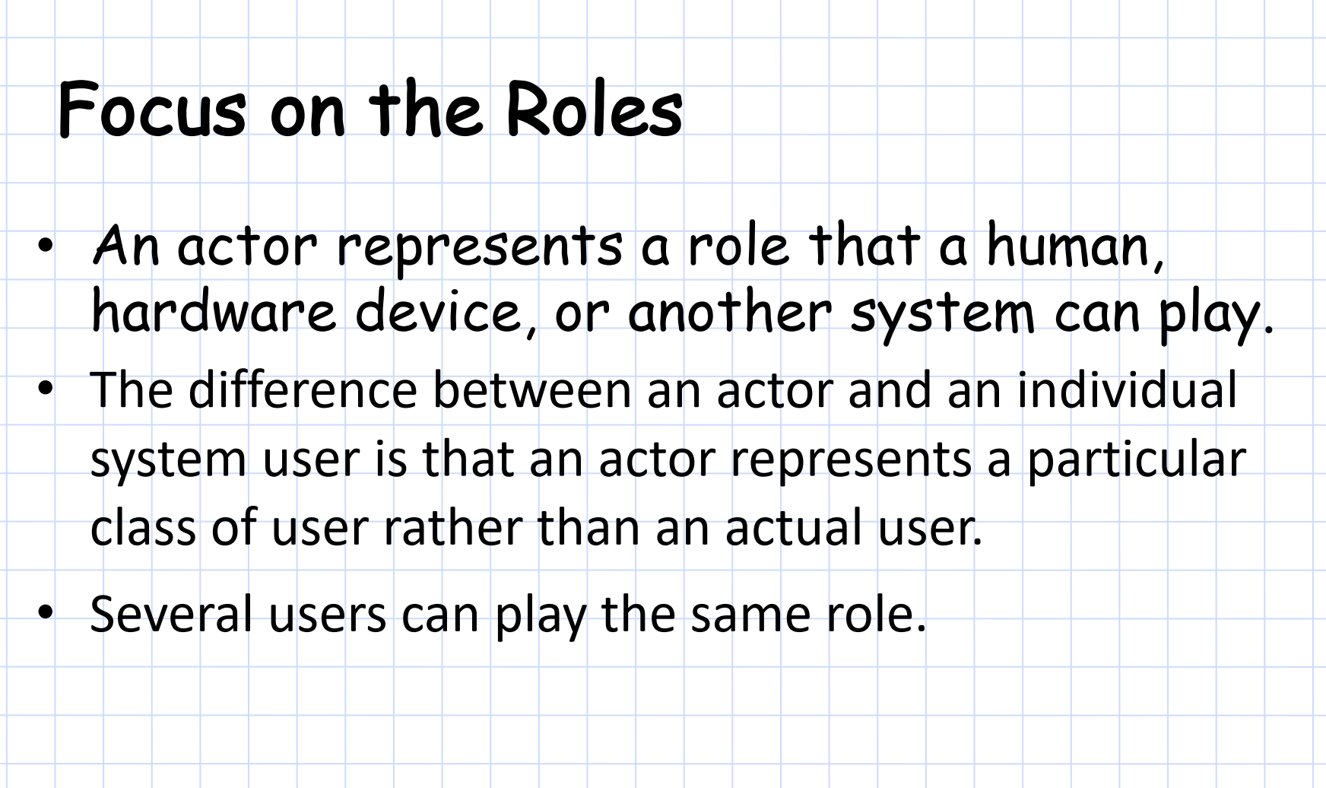
Notes:
1. Definition of an Actor’s Role
Actor as a Role: In use-case modeling, an actor represents a role rather than a specific individual. This role can be played by a human, a hardware device, or even another system that interacts with the main system.
Flexibility in Representation: By focusing on the role, the model remains flexible and can accommodate various users or systems that fulfill the same function, regardless of who or what is performing the action.
Abstract Representation: An actor in use-case modeling is an abstract representation of a role that interacts with the system. It is not meant to represent a specific person or device but rather a type or class of user.
Role vs. Individual User: This distinction allows the model to focus on the functions and interactions related to the role rather than the unique characteristics of each individual user.
Multiple Users for a Single Role
Shared Role: The model supports the idea that multiple individuals or systems can play the same role. For instance, several people can act as "Customers" in an ATM system, or multiple software applications could act as “External System” actors that interact with the main system.

Slide 13
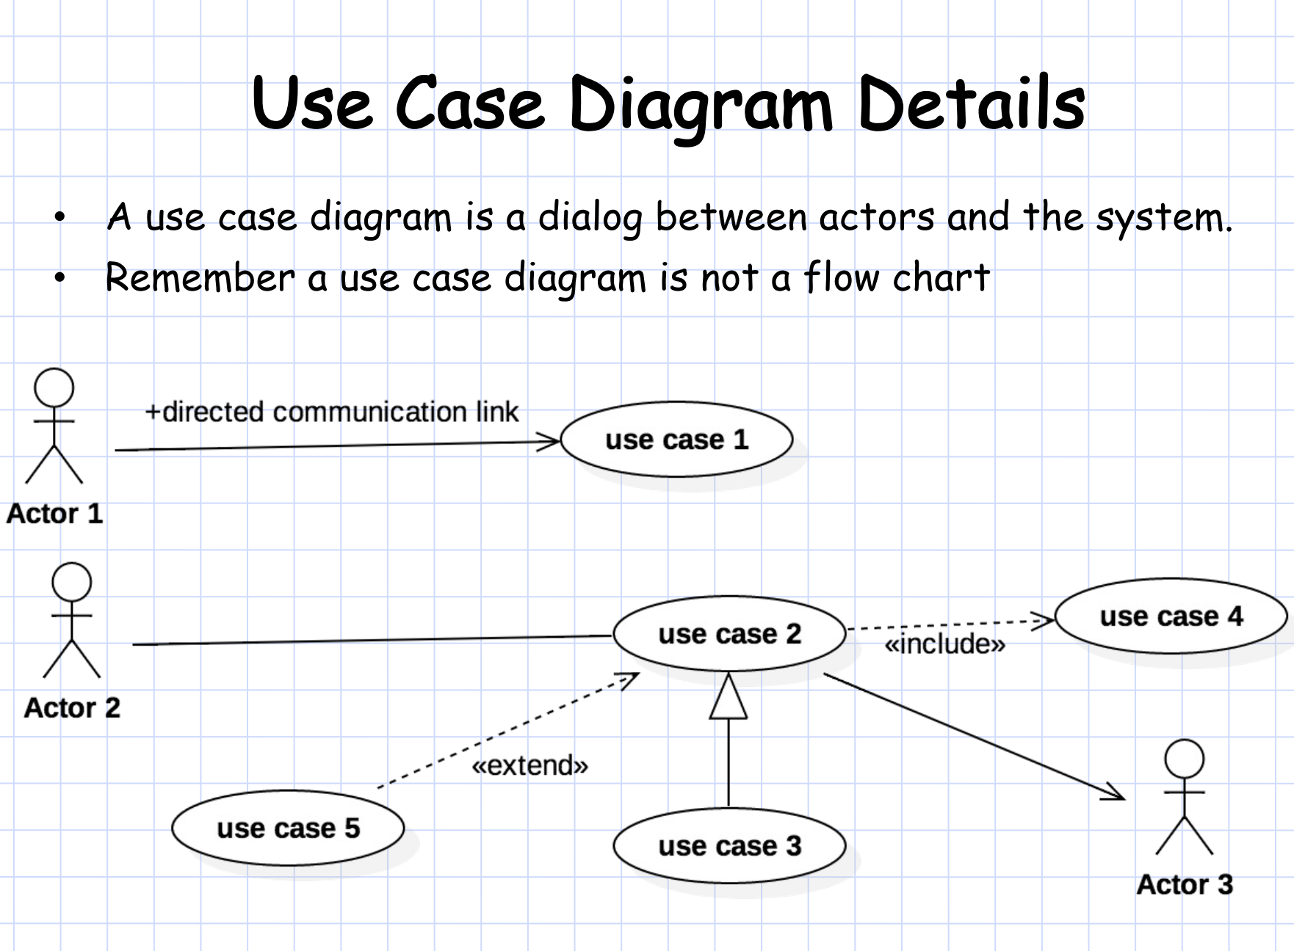
Notes:
Purpose of a Use Case Diagram
Interaction Representation: A use-case diagram shows how actors interact with the system by performing various use cases. It is a tool for understanding and capturing the system's functionalities as seen from the outside, rather than the internal processes.
Not a Flow Chart: This reminder highlights that a use-case diagram is not a flowchart. It does not illustrate the sequence of steps or the process flow within the system but instead focuses on who is interacting with what functionalities.
Communication Link
Directed Link: A solid line with an arrow, like the one between Actor 1 and Use Case 1, represents a directed communication link. This link indicates that Actor 1 initiates or performs actions within Use Case 1.
Include Relationship
«include»: The dashed arrow from Use Case 2 to Use Case 4, marked with «include», indicates an include relationship. This signifies that Use Case 2 requires the functionality of Use Case 4 as part of its process. Whenever Use Case 2 is executed, Use Case 4 is also triggered.
Example: In an ATM system, a “Withdraw Cash” use case might include “Authenticate User” because authentication is always required before withdrawing cash.
Extend Relationship
«extend»: The dashed arrow from Use Case 5 to Use Case 2, labeled with «extend», signifies an extend relationship. This relationship means that Use Case 5 optionally extends the behavior of Use Case 2. Use Case 5 is only triggered under certain conditions within Use Case 2.
Example: In an e-commerce system, a “Checkout” use case might extend “Apply Discount” if a discount is available, making the latter conditional.
Association Relationship
Association: The solid lines from Actor 2 to Use Cases 2 and 5, and from Actor 3 to Use Case 4, are associations. These connections represent that the actor has access to these specific functionalities. They help define the scope of interactions each actor has within the system.

Slide 14
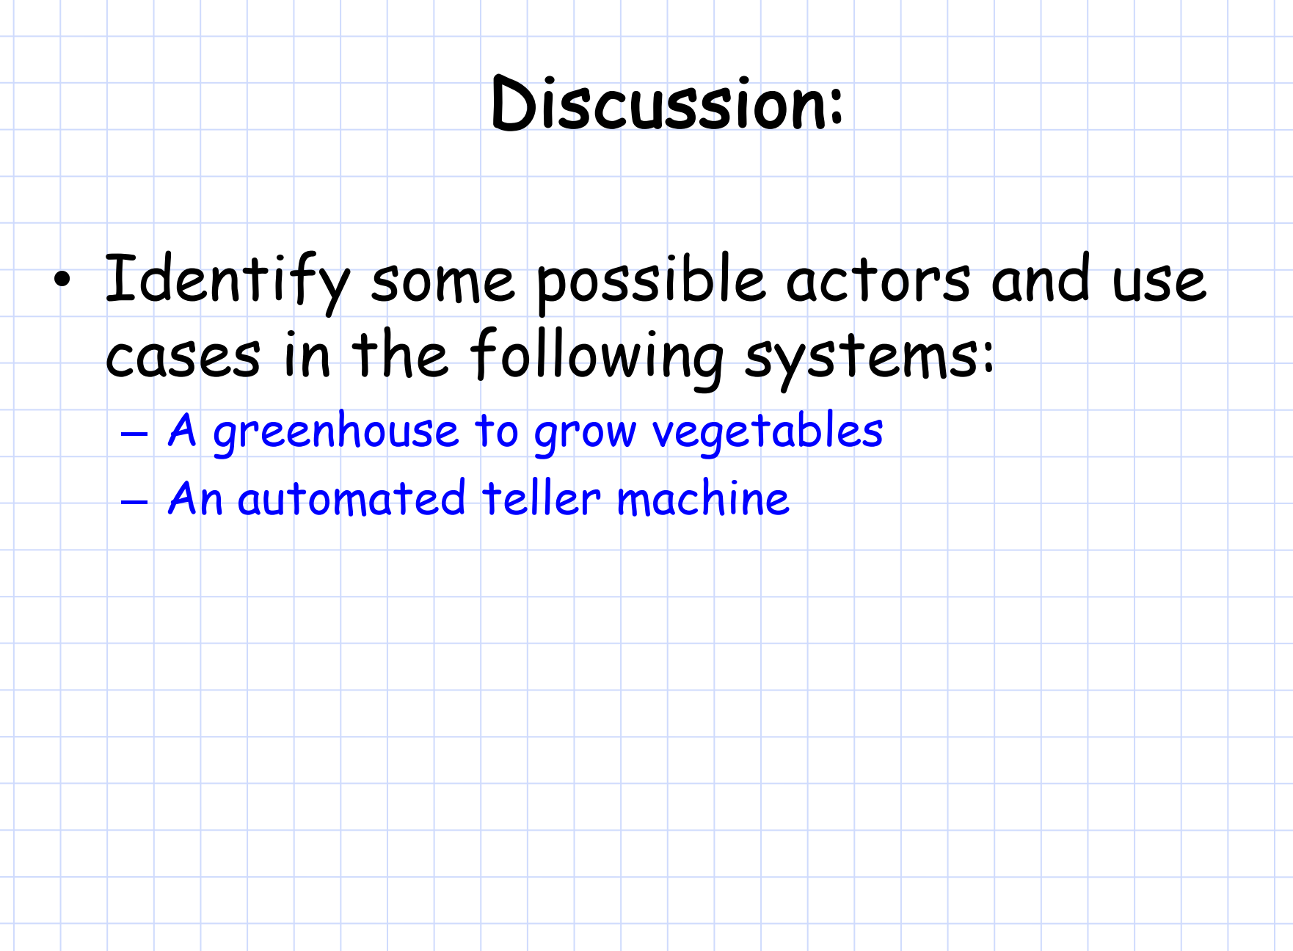

Slide 15
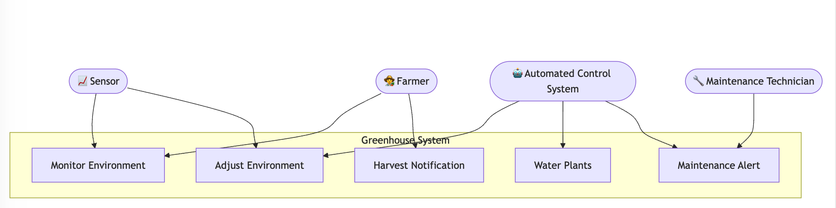
Greenhouse Use-case model

Slide 16
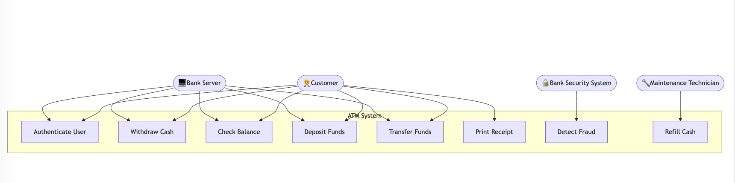
ATM

